Slide 1

Elena Stenina
Computer Programmer
2020

Slide 2


Introduction
My name is Elena Stenina. I came from Russian 10 years ago to find a new life here. I graduated college in Russia and received Bachelor Degree in Computer Science. I got my Associated Degree as Computer Programmer in USA 2017. I have two handsome sons. I worked full-time in Berkeley Electric Coop as Software Developer and working as Front-End Developer in Vectra. I love to spend a lot of time with computer to resolve tasks as front and back Developer I am very active person, like swimming, running, play tennis, play volleyball, dancing. My hobby is creating flowers’ design.

Slide 3


Introduction Cont..
I completed a Computer Programmer Associate Degree at the in 2017.
I have three Certificates as Database Administrator, Microcomputer Programming and Internet Programming
Bachelor Degree in Computer Programming.

Slide 4
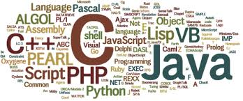
Computer Programming
I have studied extensively in the areas of web design, programming, database design and software project management. There are languages that I know:
Java Object Oriented
JavaScript, Jquery
HTML, CSS, HTML5,CSS3
SQL
C#, JAVA
Angular

Slide 5

Database Administrator
I have Database Administrator Certificate 2017. Database administrators are responsible for accurately and securely using, maintaining and developing computerized databases within a wide range of public and private sector organizations. Responsibilities of the job:
working with database software to find ways to store, organize and manage data
troubleshooting
managing database access
implementing security measures

Slide 6

Microcomputer Programming
I received Microcomputer Programming Certificate 2017. Computer programmers write code to create software programs. They turn the program designs created by software developers and engineers into instructions that a computer can follow. Computer programmers typically do the following:
Write programs in a variety of computer languages, such as C++ and Java
Update and expand existing programs
Debug programs by testing for and fixing errors
use code libraries, which are collections of independent lines of code, to simplify the writing

Slide 7
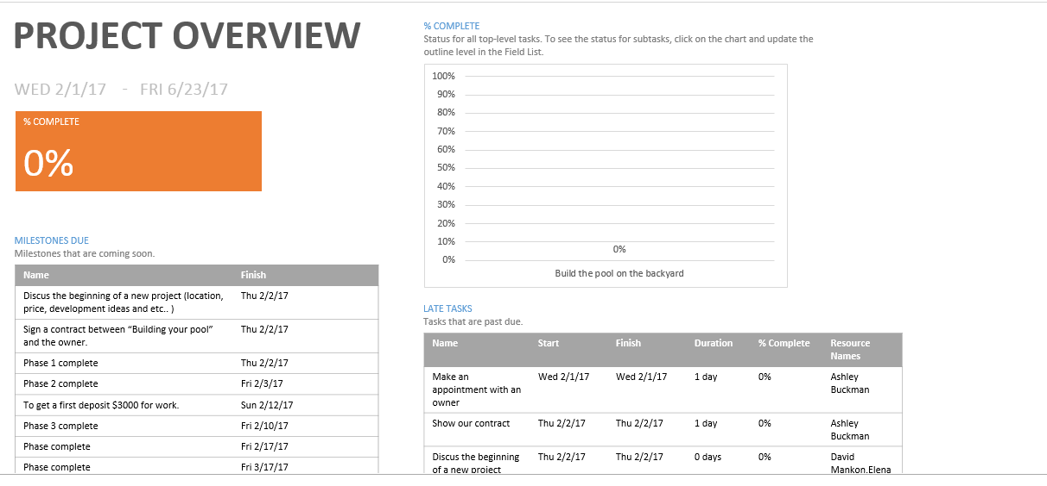
Project Manager
I have some experience as Project Manager during my school. I created my own project “ Build a new pool”. I was enjoyed to be as Project Manager. Project managers are change agents: they make project goals their own and use their skills and expertise to inspire a sense of shared purpose within the project team.

Slide 8

Role Programming in our life
Programming is a process, with 3 very important phases: Problem Identification and Solving Phase, Implementation Phase and Maintenance Phase. All three of them are important for computer programmers/software developers to be able to solve problems. A lot of developers would equate the programming process with only algorithm implementation, which is incorrect. Translating an algorithm into a programming language, which can then be compiled or interpreted and finally understood by a computer, is only a part of the programming process. In my humble opinion, it is also the easiest task.

Slide 9

Communication
My Activities in Computer field:
participation in Women in Tech,
received a scholarship from Boeing Company in 2016 and 2017, participated in Boeing tour in 2016.

Slide 10
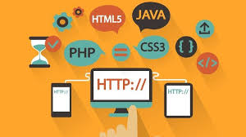
Conclusion
To be a great Full-stuck Web Developer is not easy at all but if you are hard – worker you definitely will do it.
The primary responsibilities include designing user interactions on websites, developing servers and databases for website functionality and coding for mobile platforms.

